Slide 1
Git

Slide 2
Git – installation (Windows)
Installation of Git is quick and simple.
Click on the link below
https://github.com/git-for-windows/git/releases/download/v2.5.1.windows.1/Git-2.5.1-64-bit.exe
Launch the exe file, and install.

Slide 3
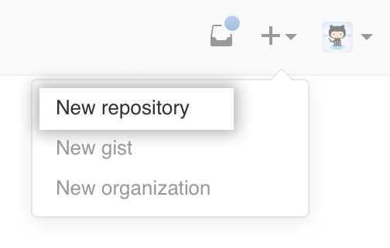
Git – Creating a repository
To create a repository you’ll first need a GitHub account.
Then you click the + icon next to your profile picture and select ‘New repository’
You then give your repository a name and set it to public or private.
You can then clone the repository to your local machine

Slide 4
Git - Configuration
You will need to configure your Git username on your local machine.
This is to ensure your commits are tracked properly by GitHub
To do this use git config –global user.name “USER”

Slide 5
Git – Basic Commands
ls – shows you the directory you are currently working in
cd filename – allows you to navigate to the selected file name
cd .. – allows you to navigate the directory above where you currently are
cd – allows you to go to root

Slide 6
Git – Basic Commands
git status – Allows you to see the stage at what your repository is like compared to the shared repository.
git pull – pulls the shared repository from GiThub and updates your local repository.
git commit –m “insert message here” – this command snapshots the changes you want to make

Slide 7
Git – Basic Commands
git add filename – takes a snapshot of the file
git push – pushes the snapshots you have taken to the shared repository
git reset <filename> - this will undo the addition of a file in git add
WARNING – PUSHING CAN CAUSE CONFLICTS

Slide 8
GiT – Ignoring files
Sometimes there are files that we don’t want to push into the repository because they are local to a machine and won’t work on another one
To do this we use a text file called .gitignore which will tell Git to not track any changes to it
For example: /.classpath

Slide 9
Git – Ignoring files
Sometimes the .gitignore file won’t be created automatically, how you create one depends on your OS
Windows: create a new text file in your project directory called .gitignore. – this will be abbreviated by Windows into a new .gitignore file, you can then edit it using a text editor of your choice
On Mac you can simply use “touch .gitignore” inside your project to create it and “nano .gitignore” to edit it

Slide 10
Git – Moving Files
In order to move a file, you need to know two things, firstly where the file is stored, and secondly where it will be moved to.
Example
git mv filename/ filelocation/
Bare in mind that locations need to be from the current position.

Slide 11
Git – Merge Conflicts
When a merge conflict happens, errors will appear in your code as Git will put all the conflicting pieces of code one after another and leave it to you to sort things out.
You need to decide which piece/s of code to use and delete the others, then commit and push to fix the conflict.

Slide 12
Git – Merge Conflicts
When you push your changes, Git merges your new additions with the repository, overwriting the old code with the new.
When more than one person has altered the same piece of code and push their respective work. Git won’t know which one to use, causing a merge conflict.

Slide 13
Git Branching
A branch in Git is simply a lightweight movable pointer to one of a commit. The default branch name in Git is master. As you start making commits, you’re given a master branch that points to the last commit you made. Every time you commit, it moves forward automatically.

Slide 14
Git Branching
Branching means you diverge from the main line of development and continue to do work without messing with that main line.
A branch in Git is simply a pointer to a commit. The default branch name in Git is master. As you start making commits, you’re given a master branch that points to the last commit you made. Every time you commit, it moves forward automatically.

Slide 15
Git Branching
Running the command: git branch [name] will create a new pointer of the name specified.
This will also change the HEAD (a pointer to let Git know which branch you are on). Any commits made to this branch are entirely separate from the other one/s.

Slide 16
Git Branch Commands
git checkout –b [branch name] – create a branch
origin [branch name] – use this during pushing and pulling to specify which branch you are referring to
git branch –d [branch name] – delete a branch
git merge [branch 1]/[branch 2] – merge two branches together

Slide 17
Git – Reversing changes
If you want to revert your local workspace to the last commit (if something has gone wrong for example) you can do so with these commands:
git clean –df (Removes all unstaged files)
git checkout -- . (Clears all unstaged changes)

Slide 18
Rules of Git
Write useful commit messages
Always pull before you push – it won’t let you anyway
Re – cloning is not a way of fixing merge conflicts
Do not commit broken code – test beforehand
Commit often, push once

Slide 19
More Rules of Git
If you have two pieces of separate functionality, that should be split into two commits
Do not merge or delete unmerged branches without everyone else’s consent
Do not push files that are different for each user for example the .classpath file

